Slide 1
Imagine Cup Junior
Lesson One – What problem does your team want to solve?
Notes:
Slide 1: This is a title slide that you can have up in class at the beginning of the lesson (or when you enter the online learning environment if you are learning remotely).

Slide 2
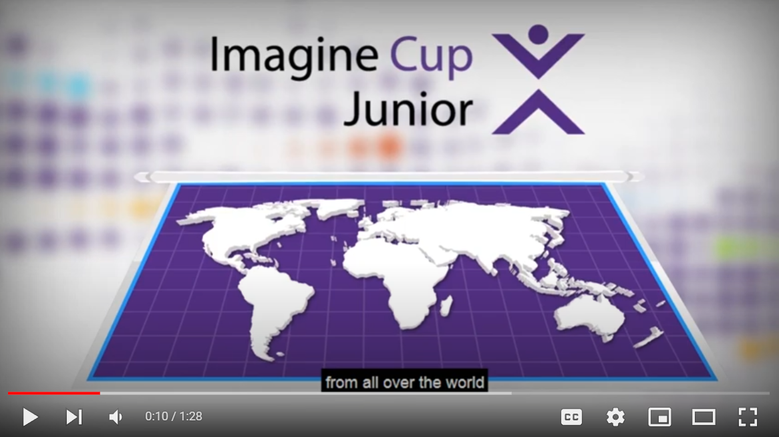

What is Imagine Cup Junior?
Introduction to Imagine Cup Junior | https://youtu.be/_o-zzES-NRg
Notes:
Slide 2: We have a video introduction. This goes for 1.30 minutes and gives your students an insight into what they will experience with Imagine Cup Junior. https://youtu.be/_o-zzES-NRg

Slide 3
What is Imagine Cup Junior?
Imagine Cup Junior is a global technology challenge for students aged 13-18.
In a team of one to six people, over six lessons, you will dream up a technology idea that will make a difference in the world. Your concept will compete with those dreamed up by thousands of other student teams from across the world.
Imagine Cup Junior 2022 is focused on AI for Good, with a particular interest on cyber-security.
Notes:
Slide 3: This slide is a recap of the video, to restate what Imagine Cup Junior is.

Slide 4
Three reasons why our class is doing Imagine Cup Junior this year.
#1 To understand AI.
Artificial Intelligence is one of the most important technologies in the world, and together we will learn about how it works, and how you could be a builder of AI, rather than just a user of it!
Notes:
Slide 4-6: These three slides are to help you engage your students and explain why you have decided to get involved in the challenge. Feel free to adapt this and reflect some of your own motivations for involving your students with Imagine Cup Junior 2022!

Slide 5
Three reasons why our class is doing Imagine Cup Junior this year.
#2 To prepare for the future.
During Imagine Cup Junior we will develop new schools around innovation, collaboration and critical thinking, all skills that are very important to help us thrive in the future.
Notes:
Slide 4-6: These three slides are to help you engage your students and explain why you have decided to get involved in the challenge. Feel free to adapt this and reflect some of your own motivations for being in involved with Imagine Cup Junior 2022!

Slide 6
Three reasons why our class is doing Imagine Cup Junior this year.
#3 To try to win great prizes!
There are great prizes available for the winning teams at the international level (and maybe at your country or regional level). It is can also be very powerful for your career development to say that you won (or took part in) Imagine Cup Junior!
Notes:
Slide 4-6: These three slides are to help you engage your students and explain why you have decided to get involved in the challenge. Feel free to adapt this and reflect some of your own motivations for being in involved with Imagine Cup Junior 2022!

Slide 7






What we will be doing across the six Imagine Cup Junior lessons.
Lesson 1
Lesson 2
Lesson 3
Forming your team and choosing your problem.
Learning about how AI works.
Learning about generative AI.
Lesson 4
Lesson 5
Lesson 6
Becoming a team of AI inventors.
Making sure your AI is good and cyber secure.
Entering a great submission to Imagine Cup Junior.
Notes:
Slide 7: This slide provides a short overview of the six lessons your class will take part in.

Slide 8
Is Imagine Cup Junior just for people who are good with computers?
Notes:
Slide 8: There is some likelihood that if your students are new to Imagine Cup Junior, that they may think it is purely a technology challenge, and only for young people who have very strong technology skills. The good news, is that Imagine Cup Junior has been created for all students, with all types of skills. Every member of your class can be part of a team that puts forward a great submission, regardless of where their strengths lie. On the next slide we have a short activity to help you encourage your students.

Slide 9

From the list below, which of these are your strengths? (pick at least two) - I’m creative and like coming up with ideas. - I’m artistic. - I’m a fast learner. - I’m good with technology, coding and gaming. - I’m a good writer. - I’m good at leading people. - I love getting things done. - I’m good at solving problems. - Something else?
Rapid Reflection
Notes:
Slide 9: Rapid Reflection - It is time for your students to take a moment to reflect on what their strengths are. Ask them to look at the list and then choose at least two strengths which they think describe them. Take a moment as a class to reflect on these, with a goal of encouraging your students to form teams where people can bring a diverse set of strengths together. You can also encourage them that to make a better world with AI we need people with skills in science, technology, engineering, math, languages, art, history, economics, ethics, philosophy, psychology, and many other fields!
At this point you should be around 8:00 minutes into your 45:00 minute lesson.

Slide 10

Sprint 1
Your team
Sprint 2
Choosing a Problem
Sprint 1 – Your Team
Goals:
Bring together your team of one to six people (aged 13-18).
As a team discuss your individual strengths, and determine how you want to work together across the next five lessons.
If you have time, open up the PowerPoint Submission template and fill out what you can on the first page.
Hints:
You are innovating and entering Imagine Cup Junior as a team, so consider how you want to work over these five lessons. For example, you might want to:
Listen to each other.
Challenge each other, but then agree.
Draw on your individual strengths.
What else?
Notes:
Slide 10: Sprint #1 – In the first ten-minute sprint your students will form their team of one to six, aged 13-18. Encourage them during this time to share their strengths and determine how they want to work together across the next five lessons. This is also a great time to share the PowerPoint Submission template with them, so that they are beginning to work on this from Lesson One. At the completion of this first sprint, you should be around 18:00 minutes into your 45:00 minute lesson.

Slide 11
Choosing a Problem
‘If I had only one hour to save the world, I would spend fifty-five minutes defining the problem, and only five minutes finding the solution.’
(Attributed to Albert Einstein)
Notes:
Slide 11: Your student teams will now focus their attention on choosing a problem in the world that they would like to solve. On this slide we share a quote that is attributed to Albert Einstein, to encourage your students to choose a problem that will set them up for success in the challenge.

Slide 12
Your team will soon be identifying a problem that you would like to solve. Let’s start by taking a look at environmental sustainability challenges.
Notes:
Slide 12-13: There are five categories that your students can identify a problem in through Imagine Cup Junior. In these next two slides Microsoft’s Chief Environmental Officer Lucas Joppa introduces how AI is being used to solve major environmental challenges. Slide 13 is a nine-minute video. If you are having difficulties accessing it, the YouTube link is here: A planetary computer for Earth - YouTube. Link: https://youtu.be/y9eJMzZEjlc

Slide 13

Notes:
Slide 12-13: There are five categories that your students can identify a problem in through Imagine Cup Junior. In these next two slides where Microsoft’s Chief Environmental Officer Lucas Joppa introduces how AI is being used to solve major environmental challenges. This is a nine-minute video. If you are having difficulties accessing it, the Vimeo link is here: A planetary computer for Earth - Vimeo.
Link: https://vimeo.com/384082830

Slide 14




AI for Good Categories
Microsoft is focused on making a difference in the world with AI in these five categories. Which category are you most drawn to?
Programs:
AI for Earth
AI for Cultural Heritage
AI for Accessibility
AI for Humanitarian Action
AI for Health
Notes:
Slide 14: AI for Earth, which Lucas Joppa talked about in the video is just one of the categories that your students can identify a problem from to solve in Imagine Cup Junior. The other four are Accessibility, Cultural Heritage, Humanitarian Action and Health.

Slide 15
Sprint 1
Your team
Sprint 2
Choosing a Problem
Sprint 2 – Choosing a problem
Goals:
As a team choose which AI for Good category you want to work in.
Identify a specific problem that you want to solve.
Search for statistics and information on that problem and begin to fill out Slide Two on the Submission template.
Hints:
- If you need more information on the five AI for Good categories visit https://www.microsoft.com/ai/ai-for-good.
Make sure your problem is specific. For example, Climate Change is perhaps too broad, but ‘a more efficient use of air conditioners’ might be more achievable (don’t pick that problem now though!).
Try to identify a unique problem. For example, solving the problem of garbage (in the land or the ocean) is something we saw hundreds of teams choose last year, and very few of them made the finals!
Notes:
Slide 15: Sprint #2 – In the second ten-minute sprint your students will achieve the following goals:
As a team they should choose which AI for Good category they want to work in. If they are having trouble choosing, you can direct them to this page: https://www.microsoft.com/ai/ai-for-good.
Once they have chosen a category they should identify a specific problem that you want to solve. Encourage them to identify problems that are very specific.
Once they have identified a specific problem encourage them to search for statistics and information on that problem and they can begin to fill out Slide 2 on the Submission template.

Slide 16
How did your team work together in that sprint? Did everyone have a chance to speak? Did you draw on each other’s strengths? How can you work together more effectively in the next Imagine Cup Junior lesson?
Rapid Reflection
Notes:
Slide 16: Rapid Reflection – If there is time have your students do a rapid reflection in their team, and engage with the following questions:
How did your team work together in that sprint?
Did everyone have a chance to speak?
Did you draw on each other’s strengths?
How can you work together more effectively in your next lesson?

Slide 17
Submission Tips
Remember you have to be in a team of one to six people, with everyone aged 13-18.
The more specific your problem is the better.
The judges will also want to see that your team knows about the problem you have identified, so take the time to research it further.
Notes:
Slide 17: Submission tip. Throughout these lessons we will share submission tips, which will help your students to put forward their best possible entry to the challenge. The tips we include in this lesson are:
Remember you must be in a team of one to six people, with everyone aged 13-18.
The more specific your problem is the better.
The judges will also want to see that your team knows about the problem you have identified, so take the time to research it further.

Slide 18

Challenge Check-in
What have you done so far?
In Lesson One you have learned what Imagine Cup Junior is.
You formed your team of one to six people, aged 13-18 years.
You chose a category (from Earth, Accessibility, Cultural Heritage, Humanitarian Action or Health), and then identified a specific problem your team wants to try to solve.
By this point, your team should be able to fill out some of Slide One and Slide Two in your PowerPoint Submission Template. Try to do this before Lesson Two!
What is next?
In our next lesson we are going to learn about AI!
Notes:
Slide 18: Challenge check-in. This is a quick moment to recap what your students achieved in Lesson 1. Specifically:
They learned what Imagine Cup Junior is.
They formed their team of 1-6 people, aged 13-18 years.
They chose a category (from Earth, Accessibility, Cultural Heritage, Humanitarian Action or Health), and then identified a specific problem your team wants to try to solve.
By this point, they team should be able to fill out some of Slide 1, and Slide 2 in your PowerPoint Submission Template. Perhaps encourage them to complete this before Lesson 2!

Slide 19
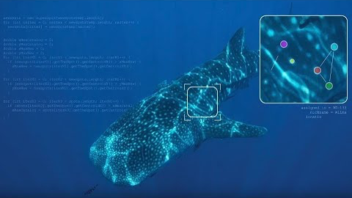
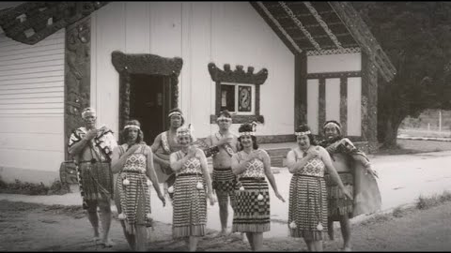
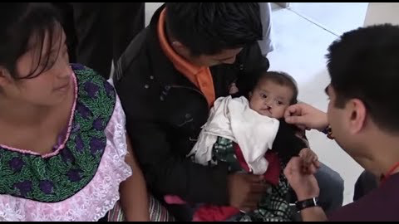
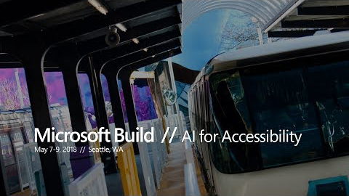

Bonus Activity!
If you would like to support your students to get inspired about each of the different AI for Good categories you can view these short videos:
Earth
https://youtu.be/rQqao37u1wU
Cultural Heritage
https://youtu.be/h8-0g0rlhKM
Humanitarian Action
https://youtu.be/7VqH9mVSWlg
Accessibility
https://youtu.be/bbrZ2pvubL0
Health
https://www.youtube.com/watch?v=ii-FfE-7C-kFfE-7C-k
Notes:
Bonus Activity!

Slide 20
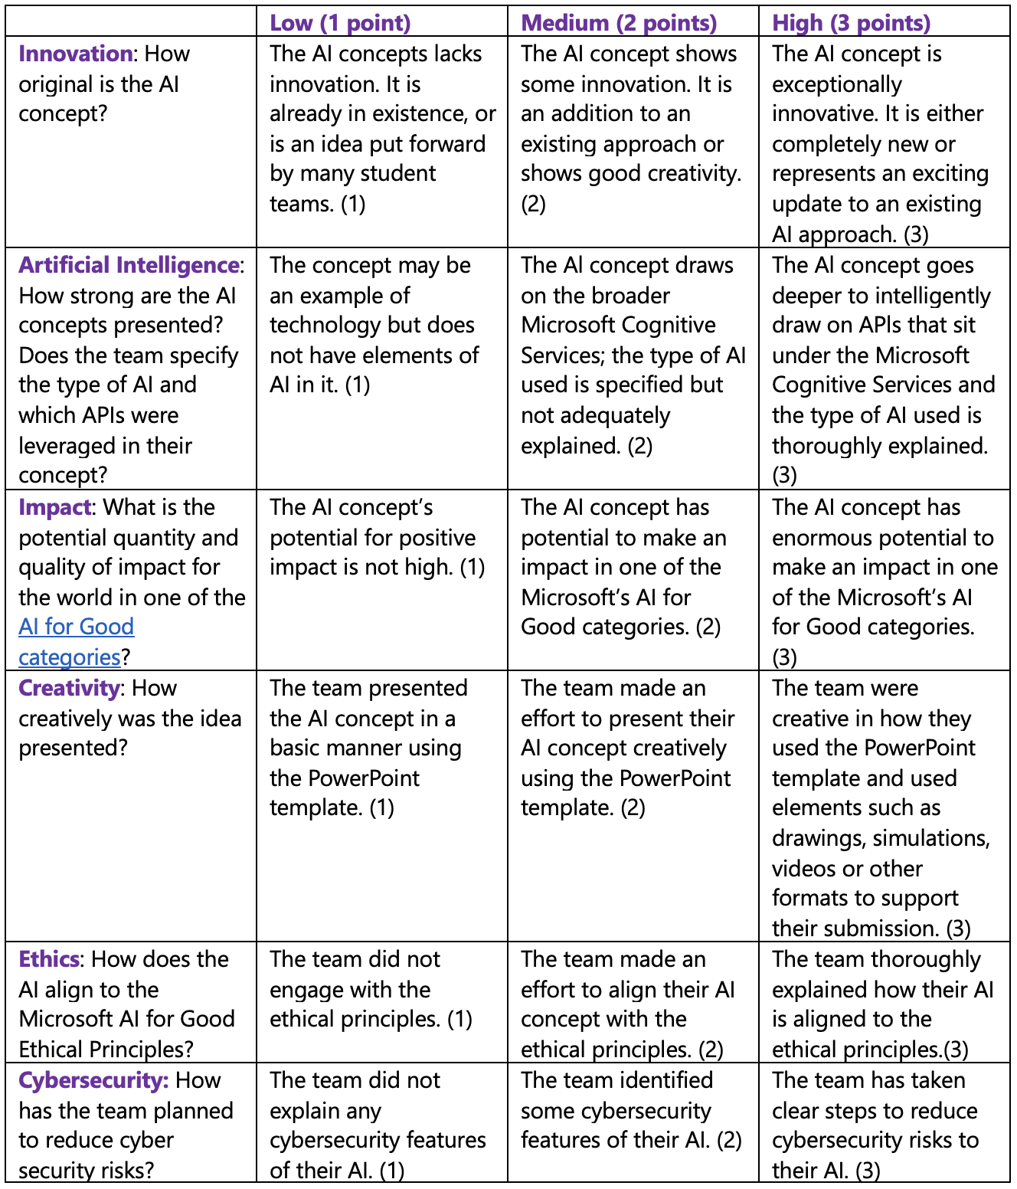
Judging Rubric
This is the rubric used by the judges to assess your student’s submissions. You can share this with your class and use it to guide their AI concepts as they fill out their PowerPoint Submission Template.
Notes:
Judging Rubric - This is the rubric used by the judges to assess your student’s submissions. You can share this with your class and use it to guide their AI concepts as they fill out their PowerPoint Submission Template.

